Slide 1
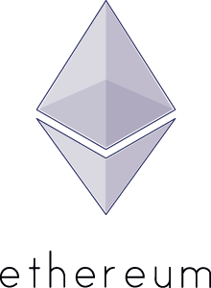
Reputation + $ +
13th July, Metalab

Slide 2

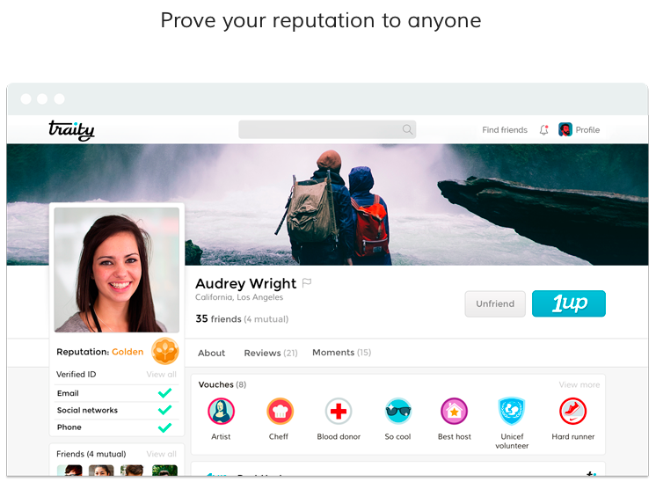
Reputation = Valuable
traity
Aggregates social media profile Reps
Received $4.7M funding
Several methods for ID proof (passport, fb, algo fraud detection)
source(s): [1, 2]

Slide 3
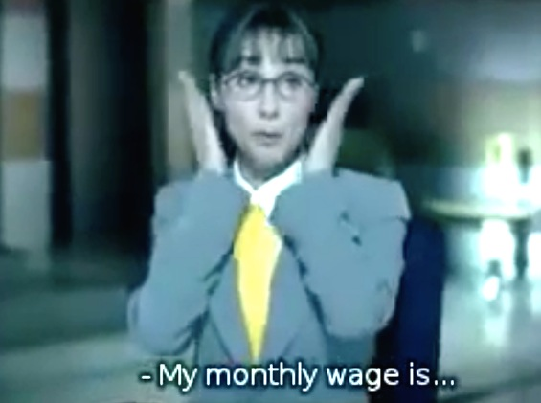



Reputation = Valuable … how?
- Reliable Job
- Credit History
(cheaper) Bank loan
Generate higher sales
Travel cheaper and better
Get a job
Customer rating
Reputation …
is context dependent: from whom, for what?
substitutes collateral (i.e. smthg. of widely accepted value put on stake)
Peer rating
Skill endorsements
source(s): [ ]

Slide 4
Preconditions to make it work
Value > Cost of Deviation
Financial Scams a la Madoff / Parmalat / Enron
Money undermines (& enables!)
paid reviews
+ … substitute
Collusion (of sybils)
Reddit voting bots
Twitter fake follower
ebay: fear of retaliation induced overrating
source(s): [3, 4]

Slide 5
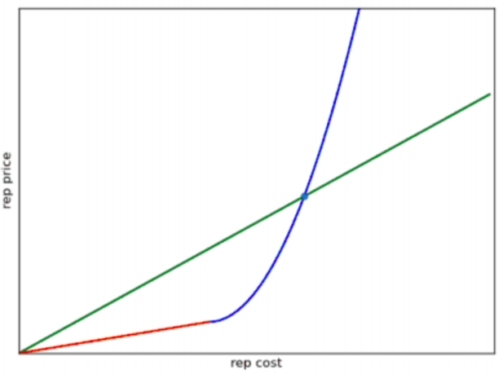
Solutionspaces to make it work … decentralized
Vlad (CryptoSwartz)
Aggregate Reps → incentive to keep one ID
However, issuing Reps must be limited/pricey
source(s): [5, 6]

Slide 6
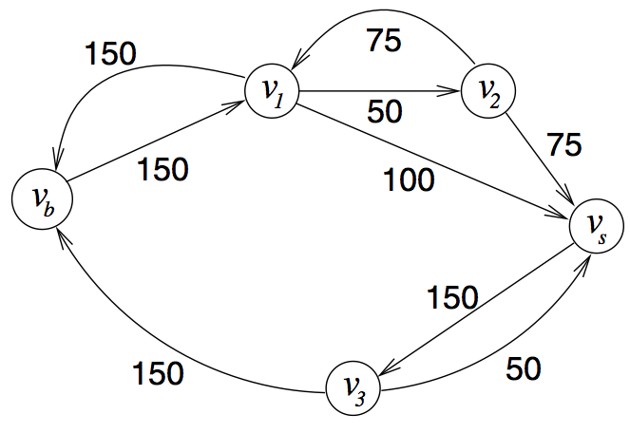
Solutionspaces to make it work … decentralized
TrustDavis
Reintroduce Collateral with References
References pay in case of loss/fault/non-performance
Ethereum contracts: easy to deploy
source(s): [7, 8, 9]

Slide 7
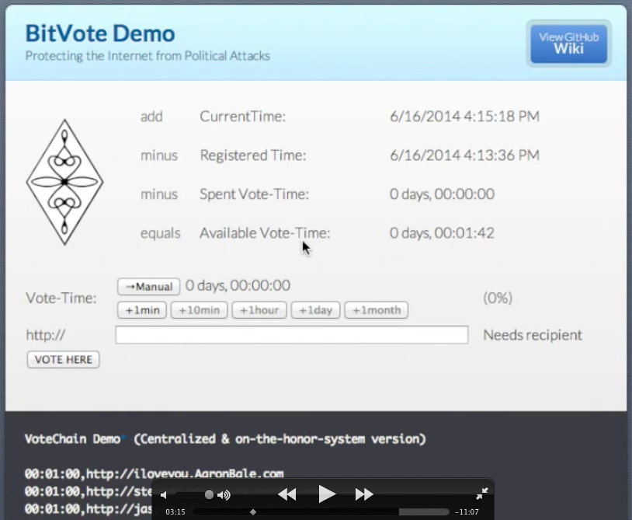
Solutionspaces to make it work … decentralized
BitVote
Tackles one ID, one vote problem
Proof of human task solving at a certain time → 'game’
Other idea: Physical meeting at random location (Jasper)
source(s): [10, 11, 12]

Slide 8

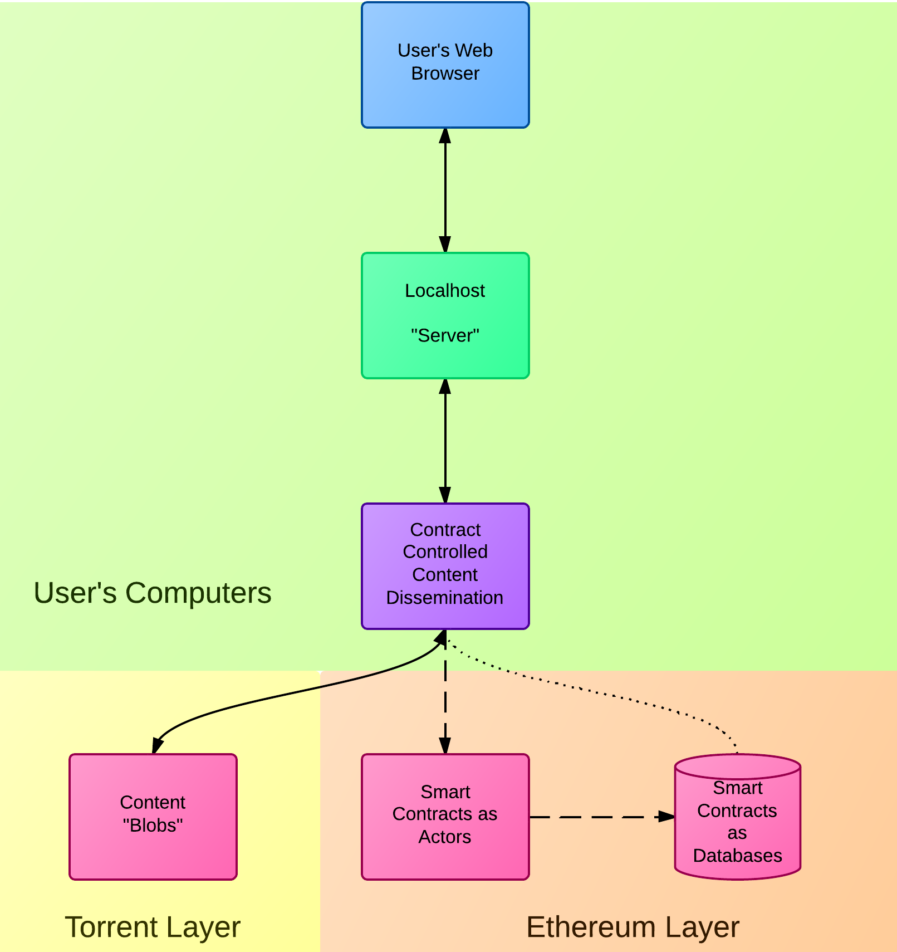
The big Enabler
Project Eris
$10k extra reward in BTC foundation reform ($100k for Lighthouse)
Decentralize everything toolkit on top of DOUG
Stores Data Hashes and Relationship Data in Ethereum, rest on Torrent (C3D = Swarm Idea)
Reddit + ’liquid democracy’ test ÐApp online
Incredibly cool
source(s): [13, 14, 15]

Slide 9
Takeaway
Prevent sybil-attacks (or make them useless)! → major factor to impede opportunistic behavior
Think about making ratings pseudonymous to alleviate fear of retaliation (reverse collusion effects)
Think about how to limit or 'price' issuing reputation, for important stuff smthg has to be on stake
Watch for clever, decentralized solutions in the future ... hot topic
source(s): [ ]

Slide 10
Sources
[1] http://techcrunch.com/2014/07/03/traity/?utm_campaign=fb&ncid=fb
[2] https://traity.com
[3] http://tomslee.net/2013/09/some-obvious-things-about-internet-reputation-systems.html
[4] http://www.chrisjonesblog.com/2013/08/how-to-spot-people-who-buy-fake-twitter-followers-and-why-if-you-do-buy-fake-followers-people-might-not-do-business-with-you.html
http://ben.orsee.org/papers/engineering_trust.pdf
[5] https://docs.google.com/file/d/0B5ir3iQlolAhdkU4Y0VEa1ZOcmc/edit Identity and Reputation System on ethereum
[6] https://www.youtube.com/watch?v=vGTd1Bi7Jrc
[7] http://www.slideshare.net/aatkin1971/trustdavis-on-ethereum
[8] http://www.reddit.com/r/ethereum/comments/28satq/ideas_on_how_the_reputation_systems_will_work/
[9] http://www.slideshare.net/aatkin1971/trust-davis-final
[10] https://www.youtube.com/watch?v=3iderhH6ttA
[11] http://bitvote.github.io
[12] https://github.com/BitVote/bitvote.github.io/wiki/1perID
[13] http://www.reddit.com/r/Bitcoin/comments/29n8o0/100000_bounty_winner_announcement/
[14] https://eris.projectdouglas.org
[15] https://www.youtube.com/watch?v=NxXoUtw7hqw
source(s): [ ]

Slide 11
The many Challenges
What you want vs. what you get
Scarcity
Waste of Res.
Consensus
Specialization
Centralization
Scalability
Bloat
source(s): []

